Slide 1
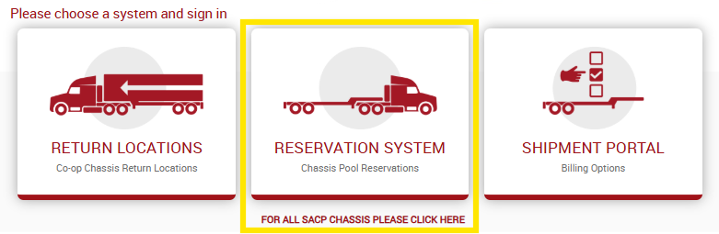
Guidelines for Using CCMShipments.com Reservation System

Slide 2
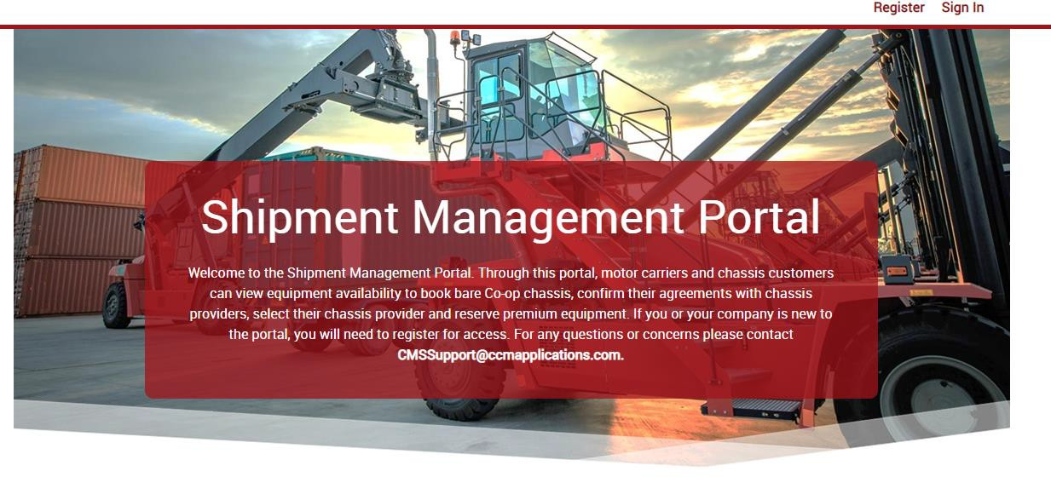
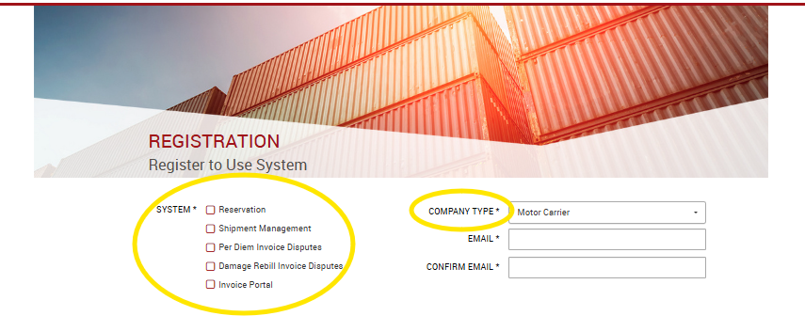

GUIDELINES FOR REGISTERING
for motor carriers
Visit CCMShipments.com and select Register from the top right corner.
If you will only be reserving
chassis, check off “Reservation”. If you also need to be able to view/pay/dispute invoices, you will also need to select Invoice Portal and Per Diem Invoice Disputes. If you need access to view and dispute damage invoices, select Damage Rebill Invoice Disputes.
Motor carriers should select motor carrier as their company type.
You will receive a new registration email after submitting your registration. Your account will be pending until a CCM Shipments System Administrator can verify your account. You will receive another email once your account has been activated.
Questions or Issues? Contact us at sacplogistics@ccmpool.com

Slide 3
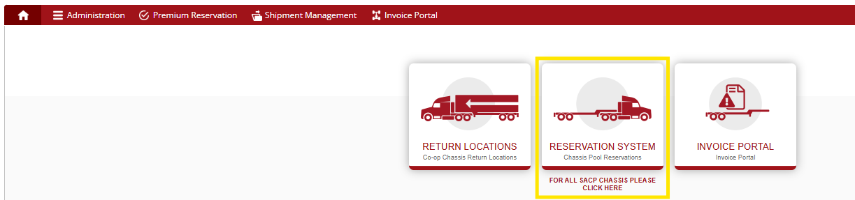
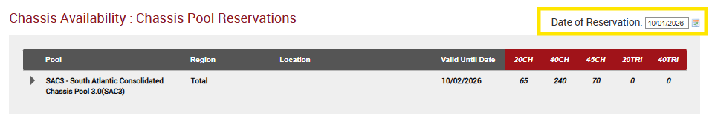

USING THE SYSTEM
You will be sent an email when your registration is confirmed. When you return to CCMShipments.com, please log in with the information that you have supplied. When you are logged in, you will view the CCM Shipments Portal screen. Click the “Reservation System” portal to view inventory.
Select the Date of Reservation. You may reserve for the current date or for a future date, dependent on equipment availability.
Questions or Issues? Contact us at sacplogistics@ccmpool.com

Slide 4

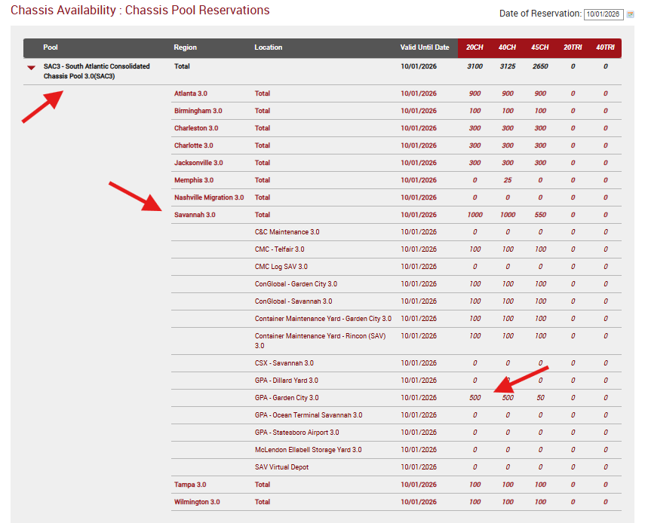
Once you have selected the date, click the Pool on the left side of the screen to display the locations and inventory available to book in each. When you decide where you would prefer to book a chassis, click on the number under the chassis size to move to the reservation screen

Slide 5
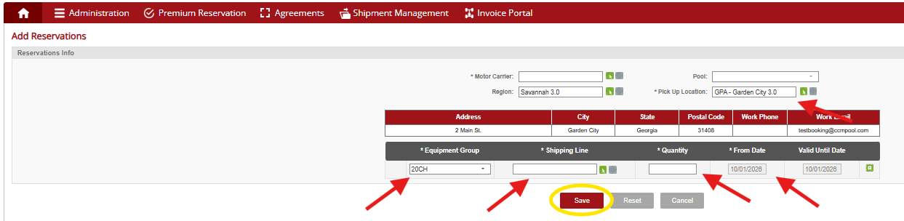
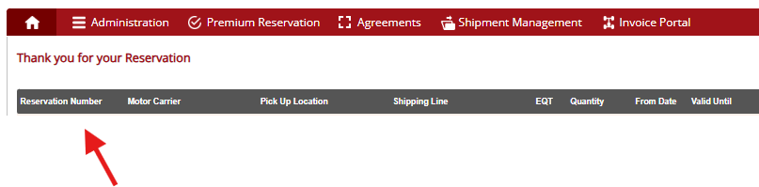
USING THE SYSTEM
The reservation screen will auto fill your company as the motor carrier as well as populating the Pool, Region, Pick Up Location, and Size that you clicked on in the previous screen. Fill in the desired quantity and Shipping Line. Check that Location, Size, and From Date fields are correctly filled out. Click save to make your reservation.
Attempting to book more chassis than are available will result in an error
message. Lower the booking quantity and click save again.
Once the reservation has been saved, the system will display a confirmation message with the pick up number and details. A confirmation will also be emailed to you and the facility to notify them of your reservation. If you have reserved for a future date, you will receive an additional emailed reminder the day prior to your pick up date.
Please note the Valid Until date, which is the last possible day to pick up equipment using the reservation.
Questions or Issues? Contact us at sacplogistics@ccmpool.com

Slide 6
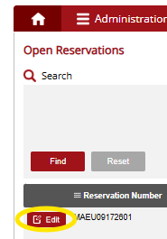
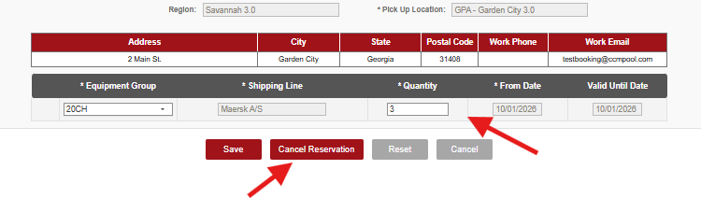
Reservations can be edited after they are created. On the Open Reservations screen, you can click the magnifying glass to search for a specific booking, and you can click Edit to change the quantity or cancel the reservation if it will not be used, freeing those chassis for use by other motor carriers.
Questions or Issues? Contact us at sacplogistics@ccmpool.com

